Slide 1


Power Up Your Configurable Apps using JavaScript 4x Functionality
Beth Romero
Kelly Hutchins
2019 ESRI DEVELOPER SUMMIT
Palm Springs, CA
Notes:
G243257 DevSummit 2019 Template for Esri staff

Slide 2

Responsive Apps
Show apps with responsive behavior

Slide 3
Accessibility
Notes:
I’ll create a demo video of tabbing through the 4.x widget showing they are keyboard accessible

Slide 4
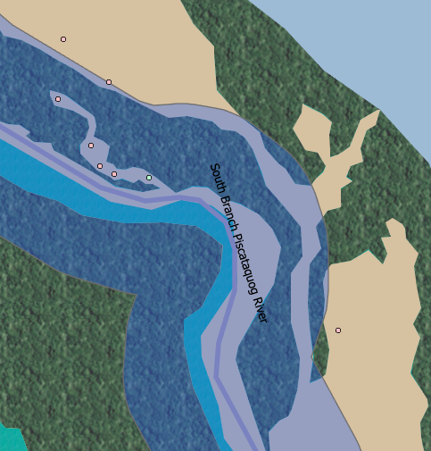
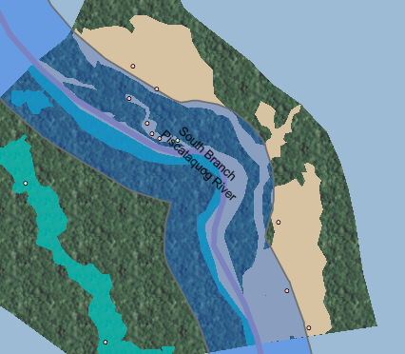
Labels – stacked (TODO replace with easier to see labels)
Notes:
One line labels in 3.x apps and map viewer
http://jsapi.maps.arcgis.com/home/webmap/viewer.html?webmap=87b586c7705b4d38ae5652e2d643715a
In 4.x app
https://www.arcgis.com/apps/Media/index.html?webmap=87b586c7705b4d38ae5652e2d643715a

Slide 5
Popups : Dock and Hover
Dock
Hover

Slide 6
Popups: Arcade
New in 4.11
Access features from any layer in map
Show demo app with popup that has arcade expression that shows other feature info.
Notes:
Not 4.x specific but an easy way to add cool functionality

Slide 7
Popup: Attachments
List view (default)
Preview
Notes:
We can demo this one with the new capability on devext to create photo layers. In Media app users can choose (List view or Preview).

Slide 8
3D
3D Apps in general
Measure/Slice capabilities

Slide 9
Screenshot
Demo interactive legend screenshot capability

Slide 10
Other widgets
Full Screen
Coords widget
Legend (card style?)

Slide 11
Filter
Talk about client side filtering in Interactive Legend

Slide 12
Performance ?
WebGl
Client side queries
Feature layer pbf
Notes:
https://developers.arcgis.com/javascript/latest/guide/release-notes/4.8/index.html

Slide 13


Slide 14

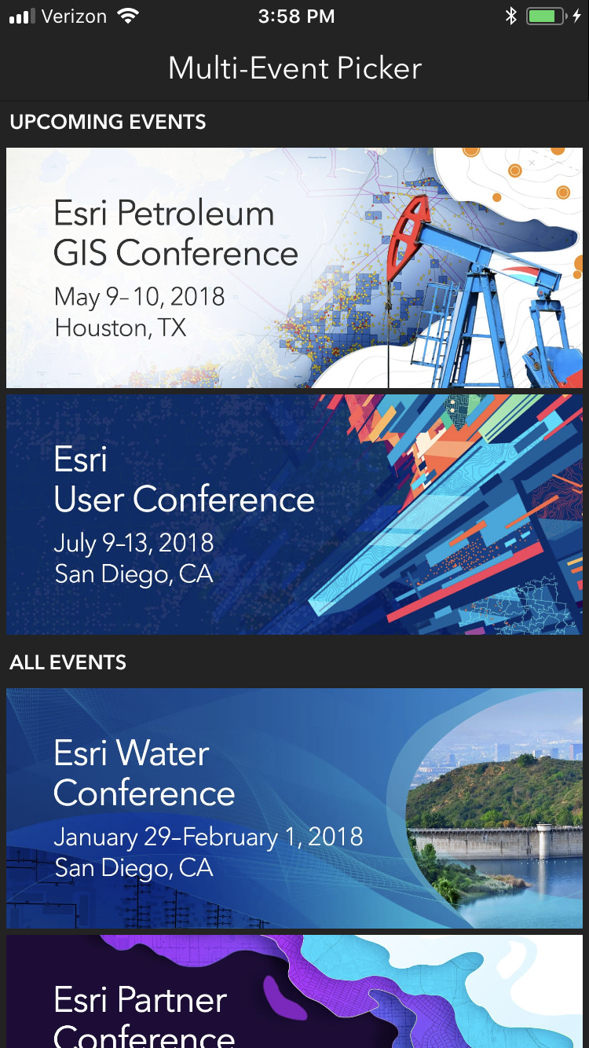
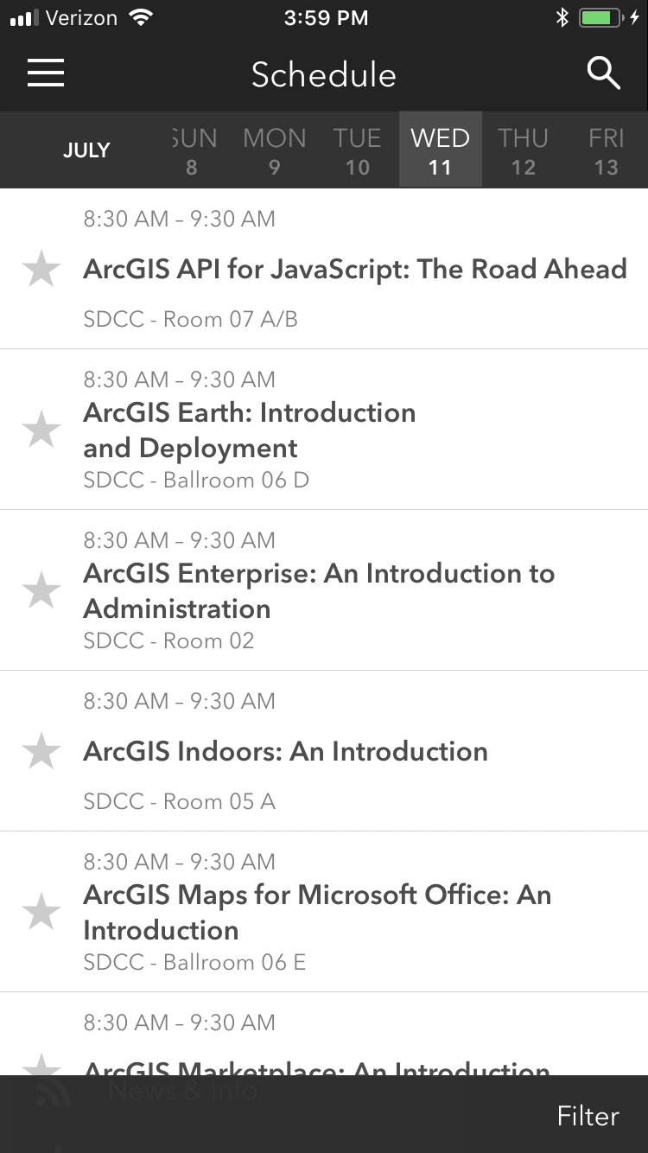
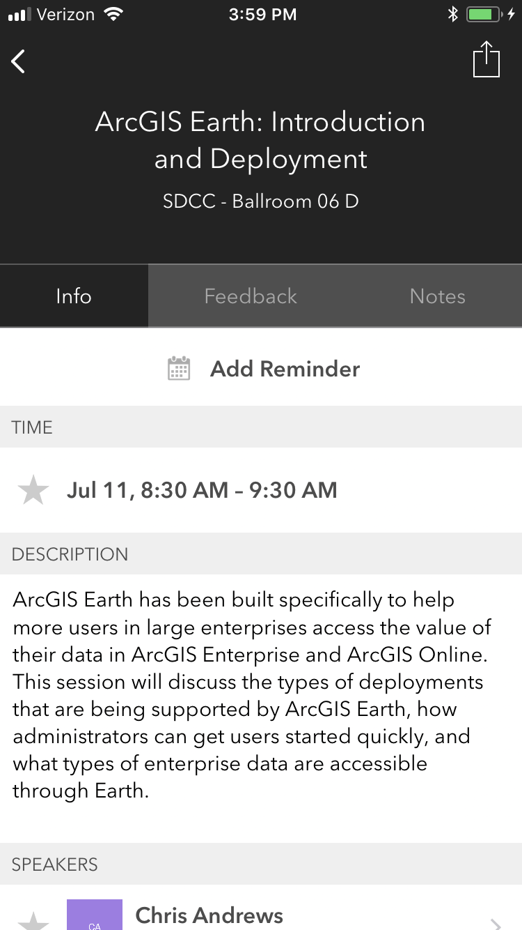
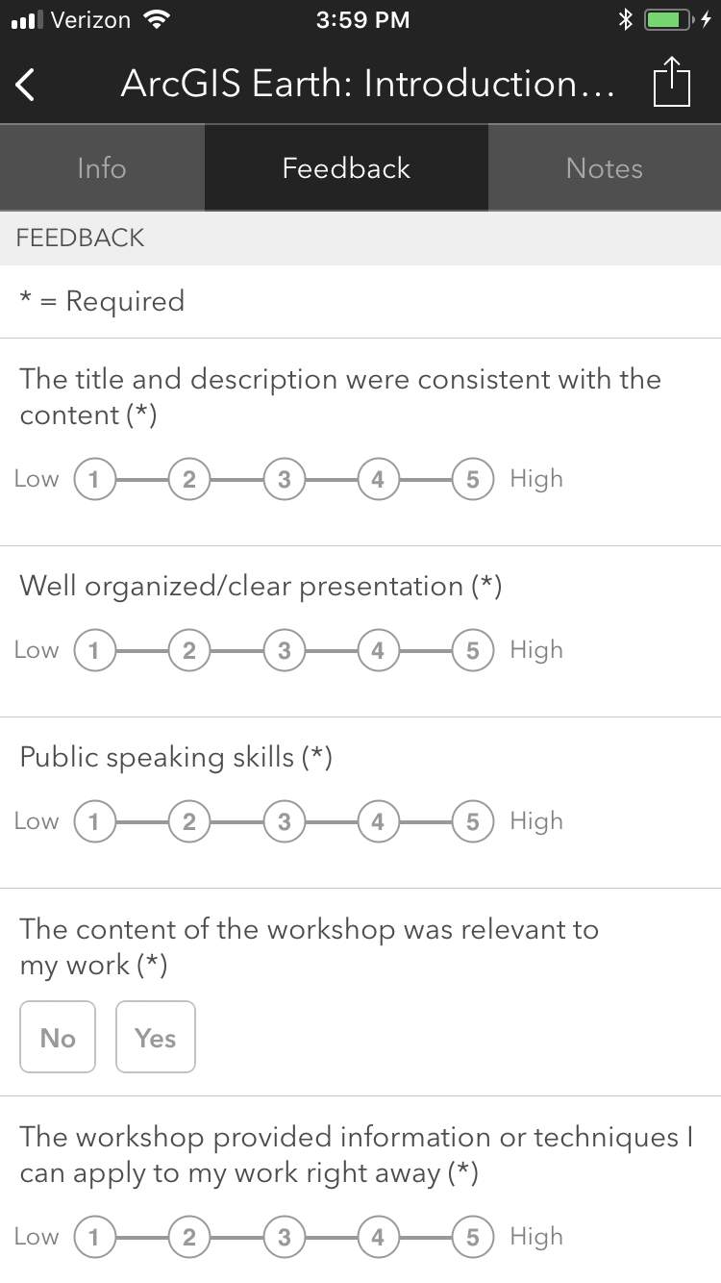
Please Take Our Survey on the App
Download the Esri Events app and find your event
Select the session you attended
Scroll down to find the feedback section
Complete answers
and select “Submit”

